Slide 1
Database
MySQL Database
Session 2
Presented by: Ma Myint Myint
12.12.2010

Slide 2
ER Model
An entity-relationship model (ERM) :provides a high-level description of a conceptual data model in a graphical notation for representing such data models in the form of entity-relationship diagrams(ERD).

Slide 3
Entity
An entity represents a discrete object of the interest to the end user and it can be thought of as nouns. There are three types of entities can be categorized for actual database designing stage
and those are:
1. Entities for resources (Static entity such as Employee, Customer)
2. Entities for transactional data (Dynamic entity such as Order, Invoice)
3. Entities for summary reports (Aggregated view such as Monthly Sales Report)

Slide 4
Entities
Employee
Customer
Order
Invoice
Monthly Sales Report

Slide 5
Attribute
Attribute is property or characteristics of entity. There are two types of attributes such as
identical and non-identical attributes. Identical attribute is called primary key of the entity and
underlined its attribute as shown in below:
Employee
Employee ID Name Gender
Order
Order Number Order Date Delivery Date
Monthly Sales Report
Product ID Area Sales Amount

Slide 6
Relationship
Relationship describes an association between entities based on business rules among those.
There are three types of connectivity are identified as shown in figure below:
One-to-many (1:M) relationship
Customer
Order
Places

Slide 7
Relationship
Many-to-many(M:M) relationship
One-to-one (1:1) relationship
Customer
Order
Product
Places
Consists of
Customer
Company
Belongs

Slide 8



Crow’s Foot symbols
Symbol | Cardinality | Remarks
 | (0,N) | Many side is optional
 | (1,N) | Many side is mandatory
 | (1,1) | 1 side is mandatory
 | (0,1) | 1 side is optional

Slide 9
E-R Diagram development
Primary Key
Foreign Key
Identifying (Strong) Relationship
Non-Identifying (Weak) Relationship

Slide 10
E-R Diagram development
Before start drawing actual E-R diagrams, we also need to understand following concepts in order to design accurate E-R model.
Primary Key A primary key is a field composite field to uniquely identify each row of the instance of entity.
Foreign Key A foreign key is a field composite field in entity that points to a primary key of another entity to implement integrity rules between entities.

Slide 11
Primary key and foreign key
Customer ID in Order entity is a Foreign Key of Customer ID in Customer entity:
Primary Key
Customer
Customer ID Name Address
Order
Order Number Order Date Customer ID
Foreign Key

Slide 12
E-R Diagram development
Identifying (Strong) relationship A identifying relationship means that the child entity (many side of the entity) can not be uniquely identified without the parent (one side of the entity).
Non-Identifying (Weak) Relationship A non-identifying relationship is one where the child entity can be identified independently of the parent entity.

Slide 13
Sample E-R Diagram for Order and Stock database
The E-R diagram below is drawn by above concepts of E-R modeling:
See in pdf-ebook (page 54)

Slide 14
Entity Relationship Modeling Practice 1
To install Eclipse
To install Clay Database Modeling plug-in for Eclipse
Create and draw a Data Model (ER Diagram) with Eclipse Clay plug-in

Slide 15
To install Eclipse
Yast/Software Management/type “java”➔ click “search” button➔ click “java 1.6”
Copy “eclipse-jee-janymede-fall1-linux-gtk.tar” from usr/local/share/linux
Extract (or) unzip this file
Start Eclipse

Slide 16
2. To install Clay Database Modeling plug-in for Eclipse
Extract “jp.azzurri.clay.core_1.4.0.bin.dist.20050831.zip” file
Copy(overwrite) extracted “plugins” and “features” folder into Eclipse folder
Start Eclipse and check Clay has been installed

Slide 17
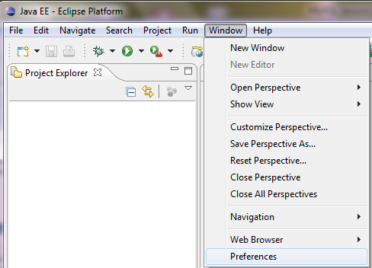
check Clay has been installed
Window/Preferences/Clay Database Modeling

Slide 18
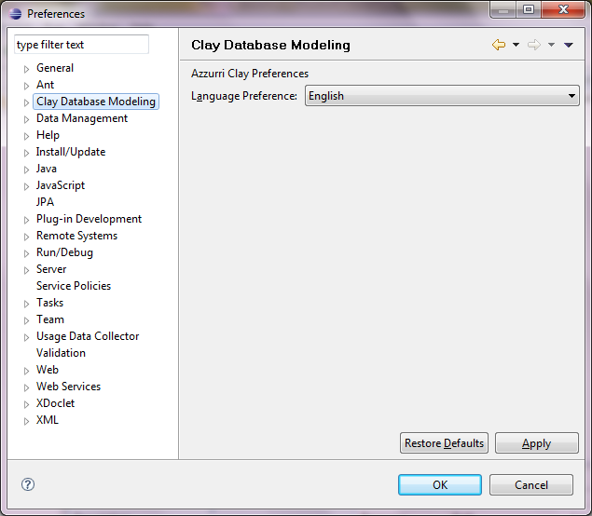
check Clay has been installed

Slide 19
Create and draw a Data Model (ER Diagram) with Eclipse Clay plug-in
Create a new project
File -> New -> Project -> Java Project -> {Enter Project Name} -> and click Finish to create.

Slide 20
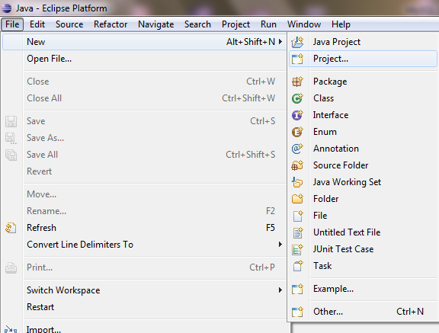
File/New /Project

Slide 21
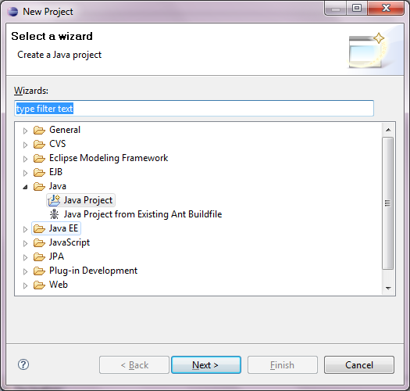

Slide 22
Thank you!!!

